Slide 1
Applying Artificial Intelligence Techniques to Prevent Cyber Assaults S.M.Al Mahin (16-31701-1) Supervisor: DR. AFROZA NAHAR

Slide 2
Abstract
Cyber security ostensibly is the discipline that could profit most from the introduction of Artificial Intelligence (AI). It is tough to make software for defending against the powerfully developing assaults in systems. It can be cured by applying techniques of artificial intelligence. Where conventional security systems may be slow and deficient, artificial intelligence techniques can enhance their overall security execution and give better security from an expanding number of complex cyber threats. Beside the great opportunities attributed to AI inside cyber security, its utilization has legitimized risks and concerns. To promote increment the development of cyber security, a holistic perspective of associations cyber environment is required in which AI is consolidated with human knowledge, since neither individuals nor AI alone has proven overall success in this sphere. In this manner, socially mindful utilization of AI techniques will be needed to further mitigate related risks and concerns.

Slide 3
Introduction
To execute versatile and persistent protection, security system need to continually conform to changing environment, threats and actors involved in the digital play. Security methodologies are routinely custom fitted to known assaults, and because of the absence of flexibility and robustness, security framework ordinarily can't adjust consequently to change in their encompassing. Indeed, even with human interaction, adaption processes are likely to be slow and insufficient. Due to their flexible and adaptable system behavior artificial intelligence techniques can help defeat different deficiencies of today's cyber security tools. Although AI has already significantly enhanced cyber security, there are likewise genuine concern. AI is proficient by concentrate how human brain thinks, and how people learn, choose, and work while attempting to tackle an issue, and after that utilizing the results of this review as a premise of creating intelligent software and systems [2].
The motivation behind this work is to highlight the deficiencies of conventional security measures and additionally the advance that has been made so far by applying AI techniques to cyber security. Furthermore this works compresses the dangers and concern connected to this advancement, by investigating AI's existing conditions, tending to present concerns, sketching out heading for what's to come .

Slide 4
Methodologies
In this section we will discuss the utilization of various AI techniques to prevent cyber assault. As we know that we are moving towards a future in which we will interact with machine which will be smarter than human beings. As the technologies are developing day by day likewise the threats and assault are also enhancing to fight against this assault we need to implement AI techniques in our security system.

Slide 5
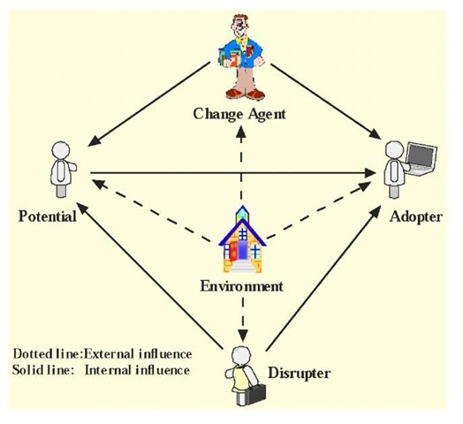
Application of Intelligent Agents
Intelligent agents are self-sufficient computer system created force that communicate with each other to share information and participate to each other so as to arrange and actualize proper reactions if there should arise an occurrence of unforeseen occasions. Their mobility and adaptability in the conditions they are conveyed in, and in addition their synergistic nature, intelligent agent technology appropriate for fighting cyber assaults.
Intelligent agents is utilized in resistance against Distributed Denial of Service (DDoS) assaults. In the wake of settling some lawful and furthermore business issues, it ought to be conceivable on a basic level to build up a cyber-police which comprises of intelligent agents (portable). Installation of infrastructure is required to support the cyber agent’s movement and communication, however should be inaccessible for foes. For entire operational picture of the cyber space a Multi- agent tools is required, for example, a neural network-based intrusion detection and hybrid multi-agent techniques already proposed in [3]. An agent based distributed intrusion detection is depicted in [4].

Slide 6
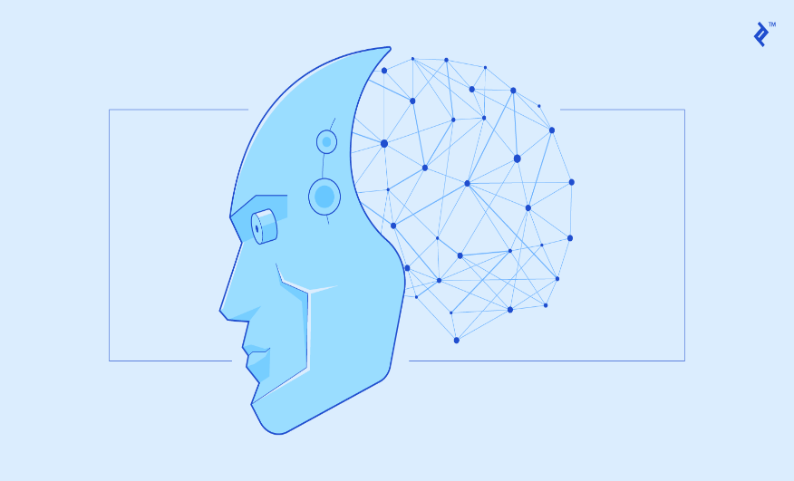
Application of Neural Nets
After the creation of perceptron by Frank Rosenblatt in 1957 Neural nets history starts – an artificial neuron is considered as important components of neural nets [5]. Perceptions can learn and tackle intriguing issues by joining in limited numbers. While countless artificial neurons are present in neural nets. Thus usefulness of greatly parallel learning and decision-making is provided by neural nets. They are known by the operation speed. Their application is for learning pattern recognition, for arrangement, for choice of reactions to assaults [6] and so forth. They support either in software or in hardware installation.
Neural nets are famous in cyber defense because of its high speed, when installed in hardware or as a graphic processors component. Various new advancements noticed in the neural nets innovation- 3G neural nets – in this biological neurons are more sensibly mimicked by neural nets, various application openings granted. By the utilization of Field Programmable Gate Arrays (FPGA) great advancement is reported such that it empower fast improvement of neural nets and their conformity to changing threats.

Slide 7
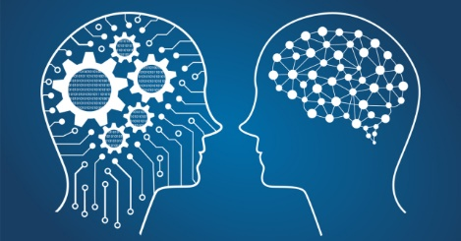
Application of Machine Learning
In machine learning, it involves computational strategies for procuring new knowledge, and also new aptitudes and better approaches to compose existing knowledge. The variation of learning problem depends upon their complexity from simple parametric learning to complicated forms of symbolic learning, for illustration, learning of concepts, even learning of behavior, grammars, and functions. Supervised as well as unsupervised learning can be used .Unsupervised learning is particularly valuable for large amount of data. This can be seen in cyber defense where expansive logs can be gathered. Unsupervised learning in AI gave the concept of data mining. Also a usefulness of neural nets can be Unsupervised learning, in specific, of Self-Organizing Maps (SOM) [9, 10, 11, 12]. Parallel learning algorithms that execution on parallel hardware is a type of learning methods. Genetic algorithms and neural nets are used to represent these learning strategies.

Slide 8
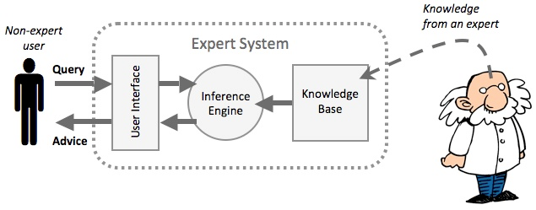
Application of Expert System
As we know the most commonly used AI tool is Expert system. It is a software which helps in discovering answers to inquiries presented either by a client or by another software. Direct utilization in decision support for example, in finances, in medical diagnosis, or in cyberspace. Expert system is for security arranging in cyber defense. It helps in determination of safety efforts, and gives direction for ideal use of resources which are limited in quantity

Slide 9
Expected Outcome
Organisations face millions of threats each day, so it would be impossible for threat researchers to analyse and categorise them all. As each threat is analysed by the machine, it learns and improves. This not only helps protect organisations now, but compiles this valuable data for use in predictive analytics .However, just staying ahead of the hackers and the threats they pose is not enough to protect organisations as the new vulnerabilities and new devices that come online will make this more and more difficult. The continued and enhanced standardisation on data formats and communication standards is crucial to this effort. Once data flows and formats are clearly defined, not just technically but also semantically, machine learning systems will be far better placed to effectively police the operations of such systems

Slide 10
Limitations
AI is by no means a cyber security panacea. When pitted directly against a human opponent, with clear circumvention goals, AI can be defeated. This doesn’t mean we shouldn’t use AI, it means we should understand its limitations. AI cannot be left to its own devices. It needs human interaction and “training” This hybrid approach already has proven itself to be a valuable asset in IT departments because it works efficiently alongside threat researchers.in AI-speak to continue to learn and improve, correcting for false positives and cyber criminal innovations.

Slide 11
Conclusion
There is additionally an earnest requirement for use of intelligent cyber defense methods in a various areas where the most appropriate technology is not only neural nets. As of recently, neither individuals nor AI alone have demonstrated general achievement in cyber security. Regardless of the immense change that AI has conveyed to the domain of cyber security, related frameworks are not yet ready to alter completely and consequently to changes in their condition. In addition a holistic view on the cyber environment of associations is required.

Slide 12
References
[1] Hal Lonas, CTO of Webroot , “The role of AI in Cyber Security”.
[2] E. Tyugu. Algorithms and Architectures of Artificial Intelligence. IOS Press. 2007.
[3] E. Herrero, M. Corchado, A. Pellicer, A. Abraham, “Hybrid multi agent-neural NIDS with MV”.
[4] V. Chatzigiannakis, G. Androulidakis, B. Maglaris. A DIS Prototype Using Security Agents
[5] F. Rosenblatt. The Perceptron a perceiving and recognizing automaton.
[6] G. Klein, A. Ojamaa, P. Grigorenko, M. Jahnke, E. Tyugu. Enhancing Response Selection in Impact Estimation Approaches
[7] D. Anderson, T. Frivold, A. Valdes. Next-generation intrusion detection expert system (NIDES).
[8] TF. Lunt, R. Jagannathan. A Prototype Real-Time Intrusion-Detection Expert System. Proc.
[9] L. DeLooze, Attack Characterization and Intrusion Detection using an Ensemble of SOM.
[10] B. Fei, J. Eloff, MS Olivier, H. Venter. The use of self-organizing maps of anomalous behavior detection in a digital investigation. Forensic Science International, v. 162, 2006,pp. 33-37.
[11] J. Bai, Y. Wu, G. Wang, S. X. Yang, and W. Qiu, A novel intrusion detection model based on multi-layer self-organizing maps and principal component analysis.
[12] V. K. Pachghare, P. Kulkarni, D. M. Nikam. Intrusion Detection System using Self Organizing Maps

